Slide 1
"Tracing the Past: The Hidden Meanings of the Names – Baltic, Lithuania, and Vilnius"
Karolina Korsak,
Adrian Kreč
Vilnius John Paul II progymnasium

Slide 2
Baltic - XIX c.

Slide 3
Baltic – 98 AD

Slide 4
Baltic – 1 c. AD

Slide 5
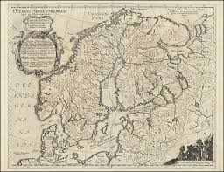
Baltic – “balteus”(belt)

Slide 6
Baltic – “bhel-”(white, fair)
According to Polish linguists

Slide 7
Baltic –”a praying woman”

Slide 8
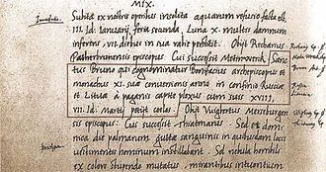
Lithuania – as Lituae (Slav) in “Quedlinburg Annals”, 1009

Slide 9
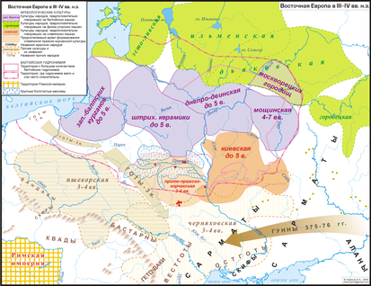
Lietuva – from the Dnepr River territory, 3-4th c.

Slide 10
Lithuania - from the proto-Lithuanian river names

Slide 11
Lithuania (river) → Lithuanians (people) → Lithuania (land)

Slide 12
Lithuania from the Baltic-Slavic “lēi” (spill)
River Lietavà or Lietáuka in Jonava District

Slide 13
Lithuania - from “lyti”, “lietus”?

Slide 14
Vilnius – as a multi-cultural centre

Slide 15
Vilnius – as "civitate nostra regia Vilna dicta" in Gediminas` letters, 1323
Gediminas, Grand Duke of Lithuania

Slide 16
Vilnius - from the Vilnia River, or “vinyti” (to wave)
River Vilnia, 1861

Slide 17
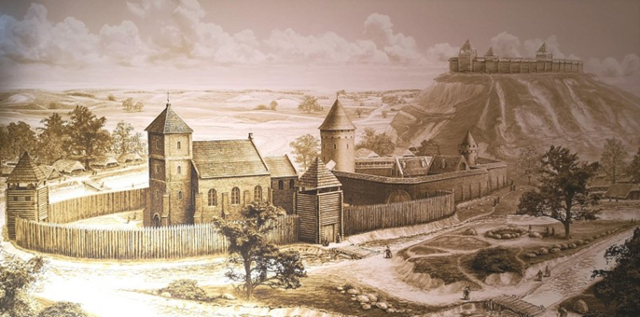
Vilnius – in M. Daukša`s „Katekizma“, 1595
Vilnius, XVII c.

Slide 18
Thank you for your attention!

