Slide 1
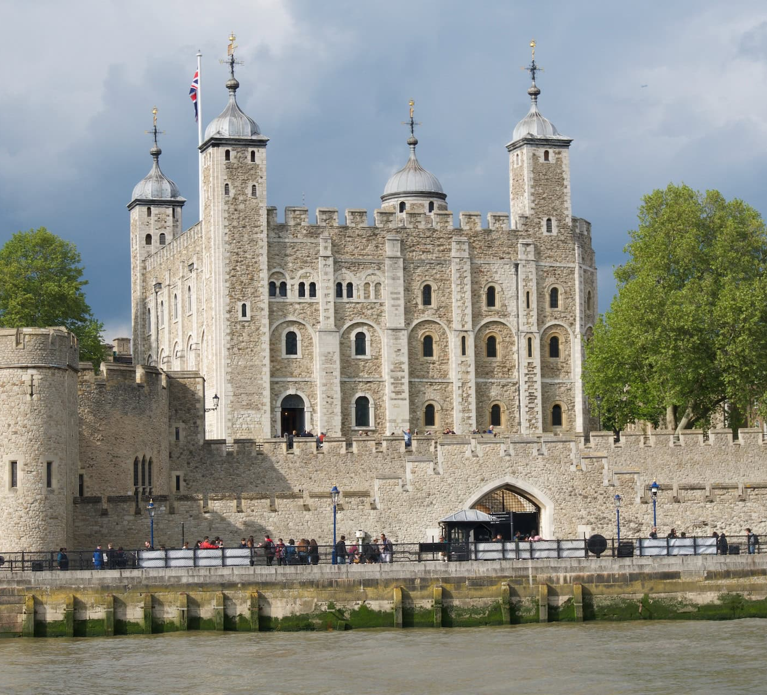
The Mysteries and Majesty of the Tower of London
Daniel Petkevič,
Robert Petkevič
Vilnius John Paul II progymnasium

Slide 2
Table of Contents:
A Royal Fortress
A State Prison
The Royal Menagerie
The Home of Royal Jewels
Yeoman Warders, or Beefeaters
Haunted by the Ghosts

Slide 3
A Royal Fortress
Built by William the Conqueror in 1068;
aimed to defend and proclaim the royal power of the first Norman King of England;

Slide 4
A Royal Fortress
Stone brought from
France;
Labour provided by Englishmen;
Took 20 years to build.

Slide 5
A State Prison
Used as a state prison during Tudor period (1485-1603);
Elizabeth I, Lady Jane Grey, Sir Walter Raleigh, and Guy Fawkes imprisoned there;

Slide 6
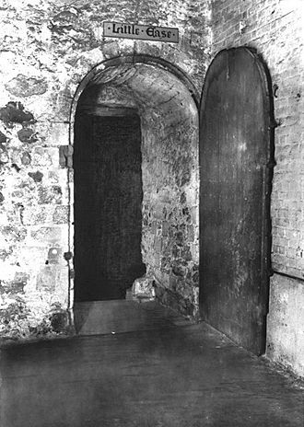
A State Prison
22 people were executed inside the Tower;
over 100 executions took place outside it on Tower Hill;
“Little Ease” – the scariest prison cell in the Tower.

Slide 7
The Royal Menagerie
Housed the zoo in the 1200s;
Animals given as gifts to kings and queens;

Slide 8
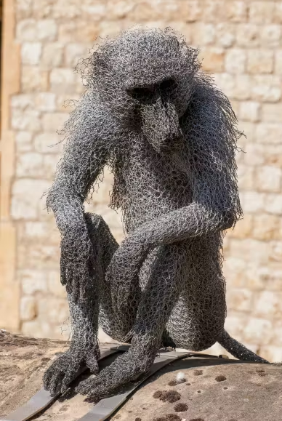
The Royal Menagerie
During 1780 a fully furnished room with monkeys;
The polar bear taken down to the Thames for fishing.

Slide 9
The Home of Royal Jewels
Houses
all the crowns and coronation items from the XVII century;

Slide 10
The Home of Royal Jewels
stunning Cullinan I, or the Star of Africa, the largest cut diamond in the world.

Slide 11
Yeoman Warders, or Beefeaters
Got their name due to their large size and the beef they were given;
Used to be elite soldiers;
Now act as tour guides; historians, and caretakers of the Tower’s famous ravens;

Slide 12
Yeoman Warders, or Beefeaters
Six ravens are kept to guarantee the safety of the kingdom;
the Royal Observatory moved to Greenwich.

Slide 13
Haunted by the Ghosts
Anne Boleyn - the second wife of King Henry VIII;
Arbella Stuart, the cousin of Elizabeth I;
the 'Princes in the Tower’ - Edward IV`s sons Princes Edward and Richard;
A huge bear.

Slide 14
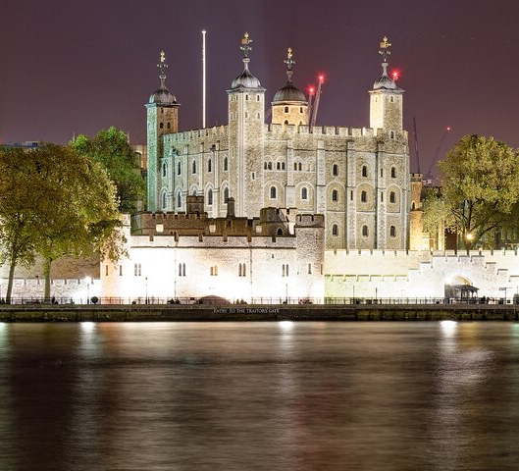
Behind its thick stone walls lie centuries of secrets, just waiting to be uncovered…

Slide 15
References:
1. 7 fun facts that will surprise you about The Tower of London
[interaktyvus]. [žiūrėta 2025 balandžio 5 d.]. Prieiga per internetą:
<https://www.bbc.co.uk/programmes/articles/5wlKRnCq2xQY5VY7qYPLBRH/7-fun-facts-that-will-surprise-you-about-the-tower-of-London>
2. Exploring the Tower of London: Unraveling History & Mysteries
[interaktyvus]. [žiūrėta 2025 balandžio 5 d.]. Prieiga per internetą:
<https://www.come-to-london.com/exploring-the-tower-of-london-unraveling-history-mysteries-s623>
3. Tower of London | History & Facts
[interaktyvus]. [žiūrėta 2025 balandžio 5 d.]. Prieiga per internetą:
<https://www.britannica.com/topic/Tower-of-London>

Slide 16
References:
4. The Tower of London prison
[interaktyvus]. [žiūrėta 2025 balandžio 5 d.]. Prieiga per internetą:
<https://www.hrp.org.uk/tower-of-london/history-and-stories/tower-of-london-prison/#gs.lf6dbs>
5. The Elephant in the Tower - Aggressive Dog
[interaktyvus]. [žiūrėta 2025 balandžio 5 d.]. Prieiga per internetą:
<https://aggressivedog.com/2023/10/28/the-elephant-in-the-tower/>
6. The story of the Tower of London
[interaktyvus]. [žiūrėta 2025 balandžio 5 d.]. Prieiga per internetą:
<https://www.hrp.org.uk/tower-of-london/history-and-stories/the-story-of-the-tower-of-london/#gs.lfb0vr>

